Slide 1
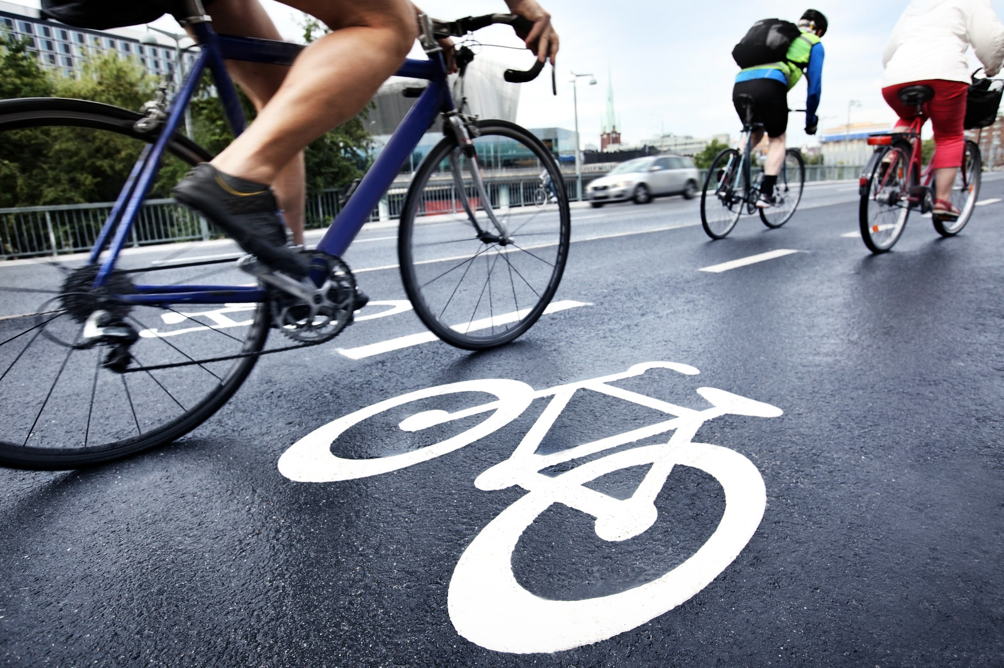
Cycler
“For safer travel”

Slide 2
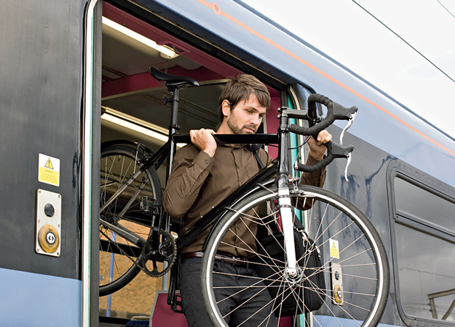
Who is it for?
Cycler would be used by the everyday bicycle rider.
May be especially useful for commuter, long distance, and professional cyclists.

Slide 3
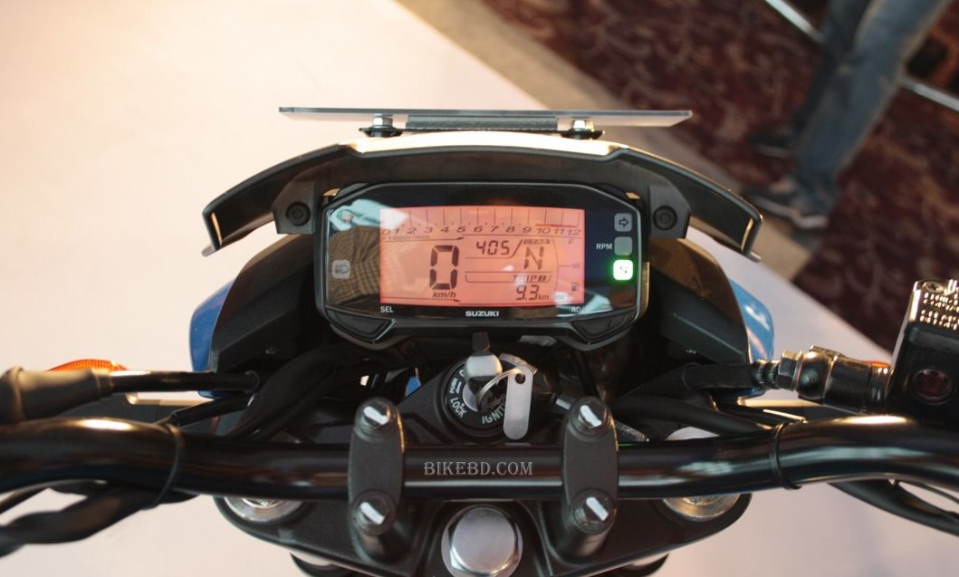
What is it for?
Cycler is a complete data collecting system that allows bicycle riders to stay up to date with information that may be crucial for their trip.
The system warns about recent hazards in the area as well as weather advisory that may affect travel.
In case of an emergency, cycler would be able to contact help and send a report of your location.
Cycler would be able to collect the data of an accident.

Slide 4
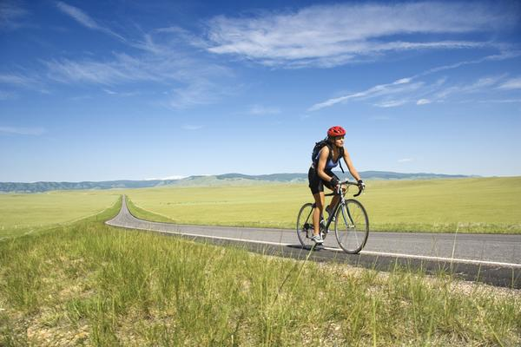
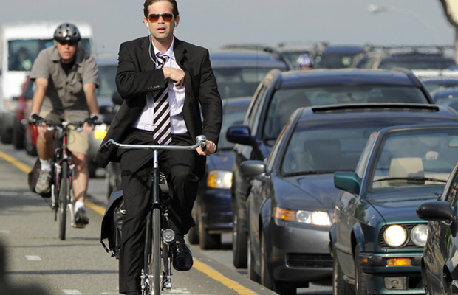
When will it be used?
Having a system attached to your bike allows cycler to be used whenever a cyclist wishes to ride.
The system would be lightweight in order to not hinder the rider.

Slide 5
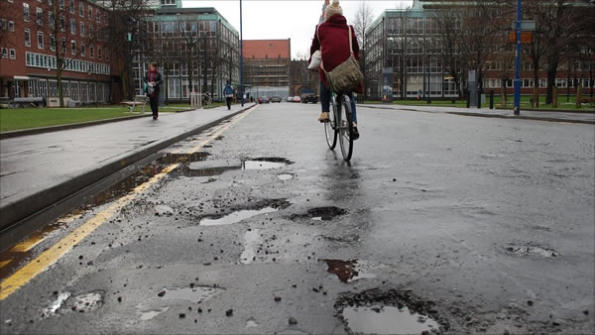
Why does it need to exist?
With a growth of bicycle riders in urban areas, Cycler is a necessity to keep people safe on the road especially in busy or hazardous conditions.
Like car drivers using their dashboards, cyclist may require information like weather conditions and navigation while riding.

Slide 6
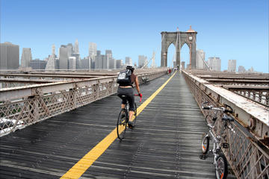
Where will it be used?
Cycler could essentially work wherever the user is riding.
This device would work well for both urban and long distance travel.

Slide 7
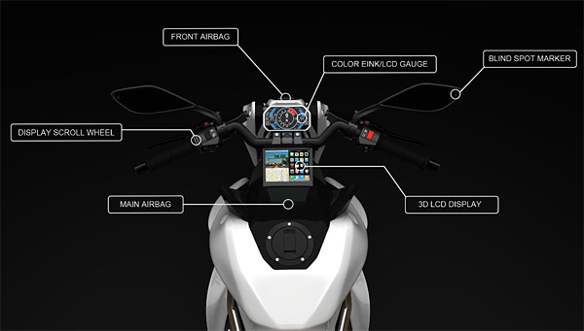
How does it work?
Inputs | Outputs
Bike mount for device
GPS location/signal | Dashboard compiles information to display to the user. User can recite commands to direct system to information pulled from internet connected device like a smartphone. In case of an emergency, user can touch for help. Device would record crash information.
Telephone transmitter/receiver Voice Control User touch

